Slide 1
ADDITIONAL RESEARCH EFFORTS

Slide 2
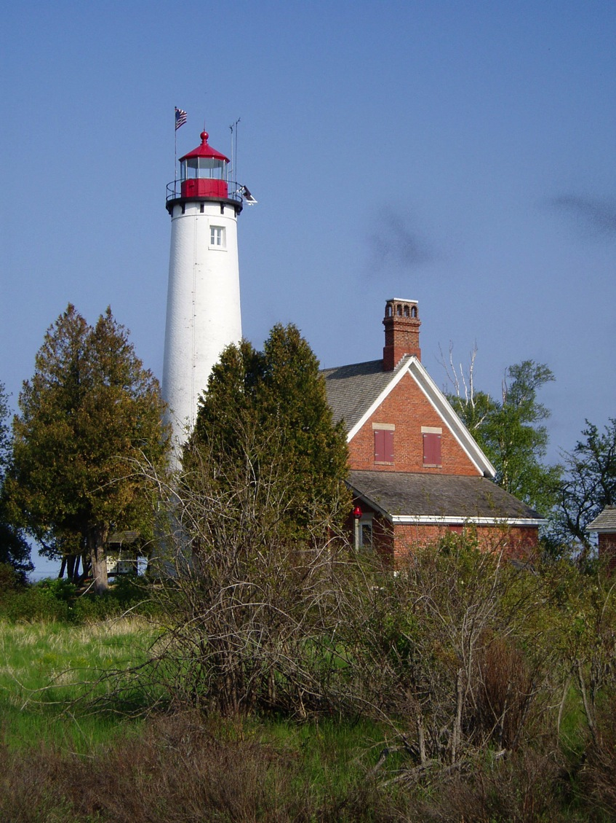

Slide 3
Additional Research Efforts
WA additional comparison of attorney/no attorney.
Who should represent the child in such proceedings? A lawyer? A CASA? A social worker? A team?
(What organizational structure best delivers legal services for a child?)

Slide 4
Multidisciplinary - Lawyers Plus
Seeking:
Law office
Assisted by non-lawyers.
Representing some but not all children in jurisdiction.
Contact Robbin Gonzalez.

Slide 5
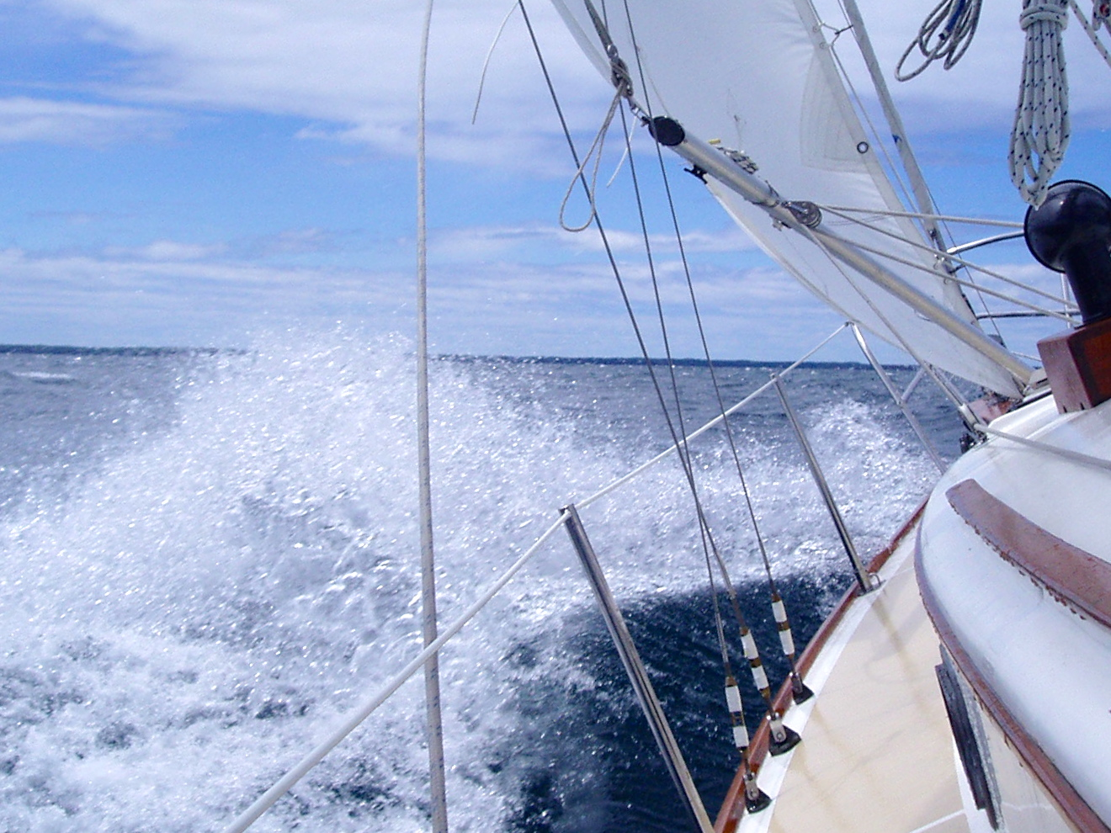

Slide 6
6. QIC MODEL: SIX CORE SKILLS

Slide 7
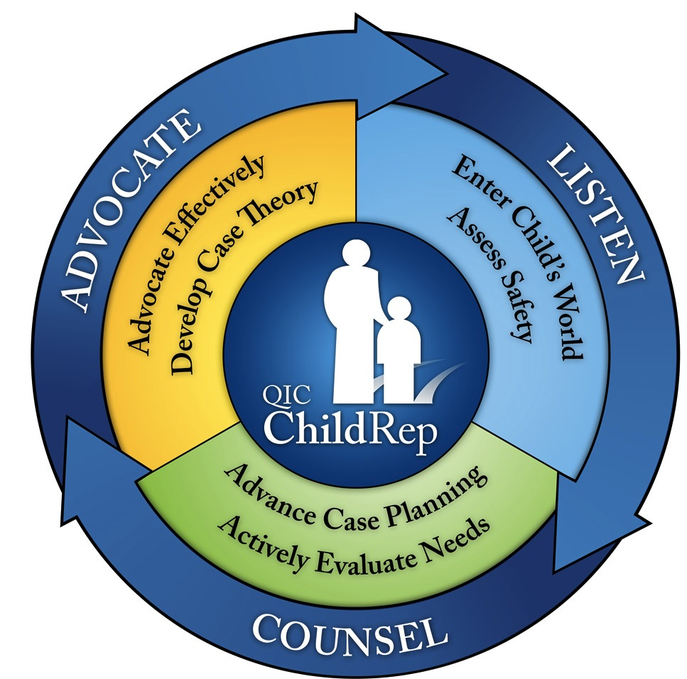

Slide 8
Training in QIC Model: Unique Skills
Enter Child’s World
- Accommodate Wishes
Assess Safety
Actively Evaluate Needs
Advance Case Planning
Case Theory-Drive the Bus
Advocacy Corollaries

Slide 9
Enter the Child’s World
Notes:
Lucy, Looking for me.

Slide 10
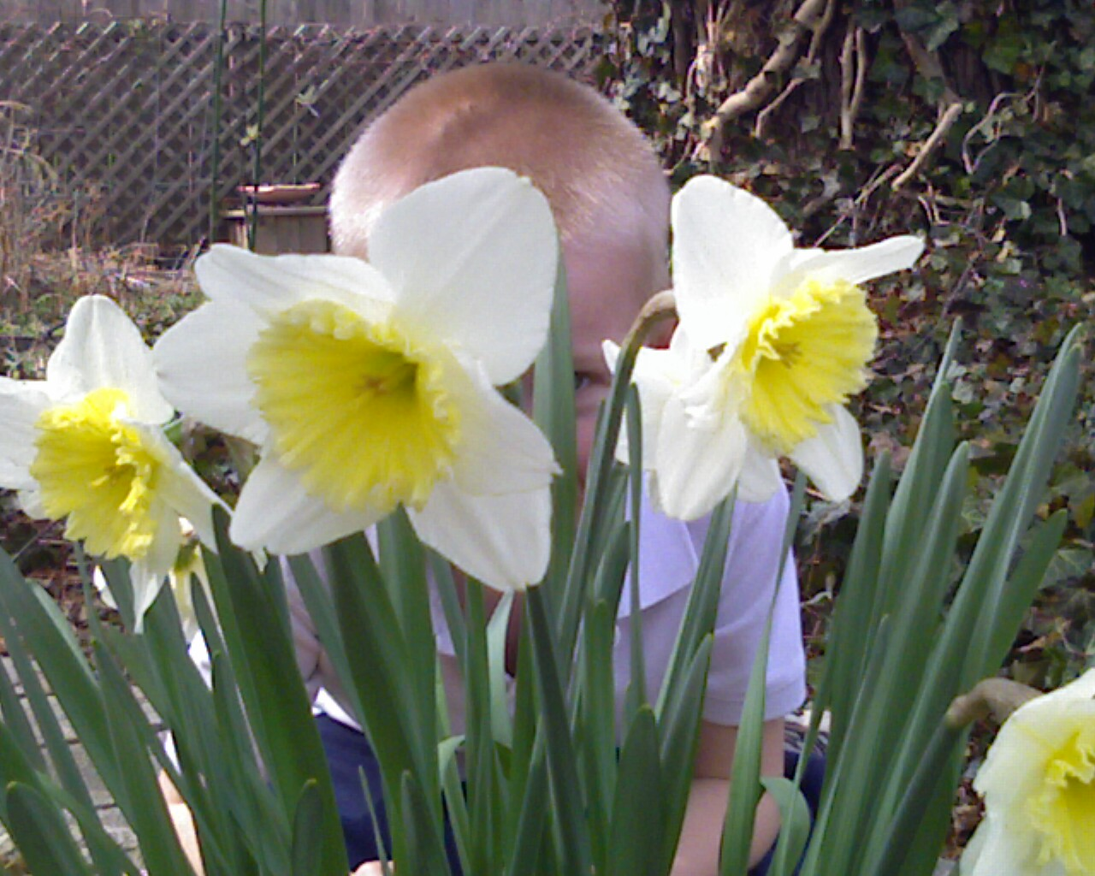

Slide 11
Assessing Safety
Threats
Are there insufficient protective capacities to protect from threats to which the child is vulnerable?
Vulnerabilities
Protective Capacities
Notes:
Renne and Lund; Ask at each hearing – Why can’t this child go home? We remove kids too often and they stay in care too long. Separate safety plan from a case plan.

Slide 12
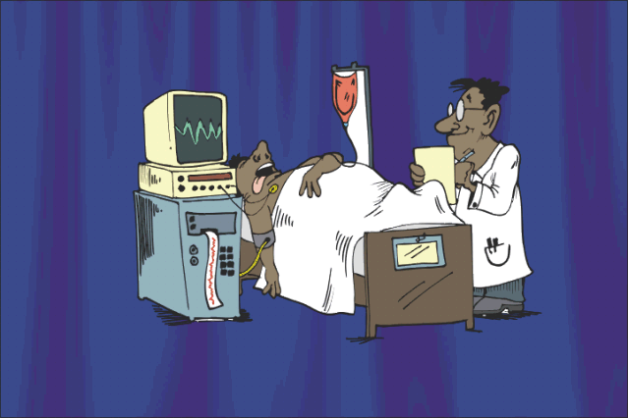
Actively Evaluate Needs

Slide 13
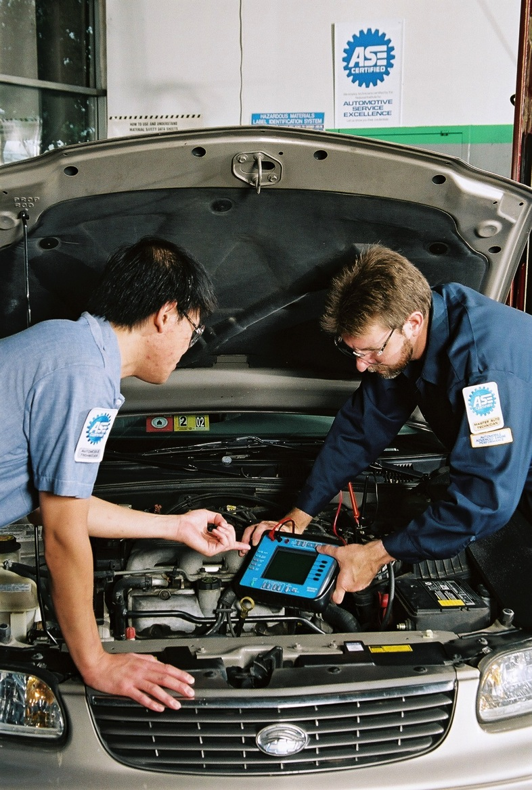
Notes:
Kathleen Faller – Full assessment of cases at front end dramatically improved case course – earlier return, earlier permanence.

Slide 14
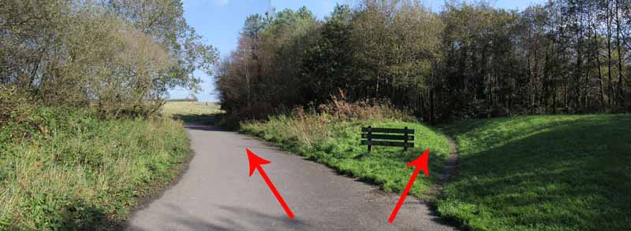
Advance an Appropriate Case Plan

Slide 15
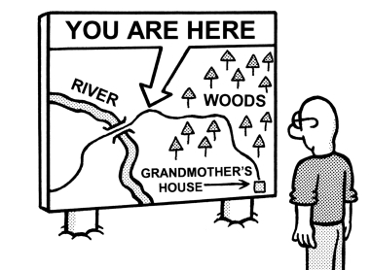

Slide 16
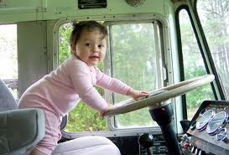
Develop a Theory of the Case: Where is this case going? (Drive the bus). Gives force and direction to your advocacy!

Slide 18
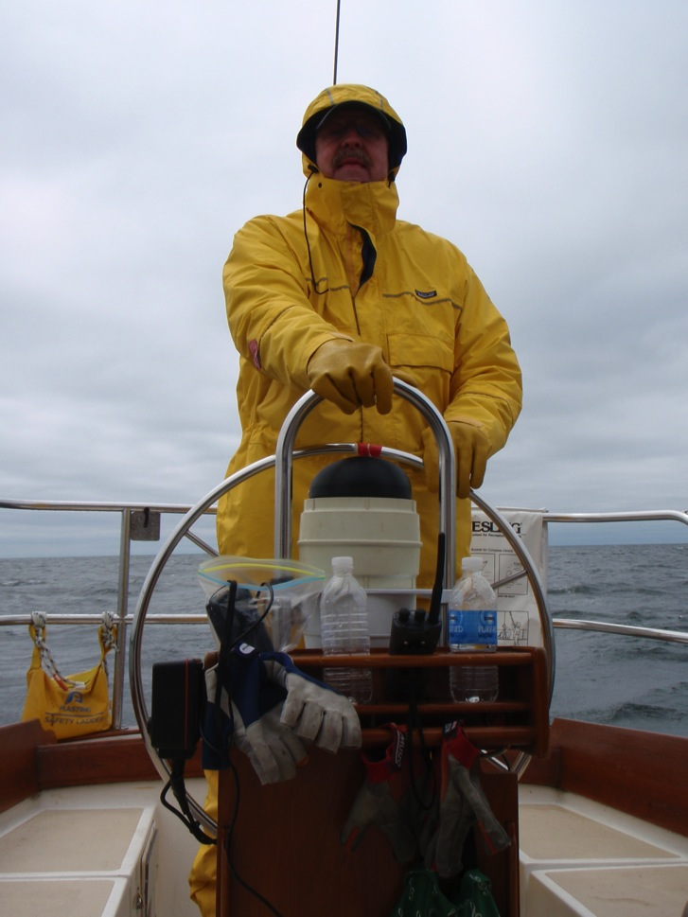

Slide 19
QIC Skills: Advocacy Corollaries
Problem-solving – stress non-adversarial approaches.
For each need find the advocacy corollary.
Use mediation skills
Use trial skills

Slide 20
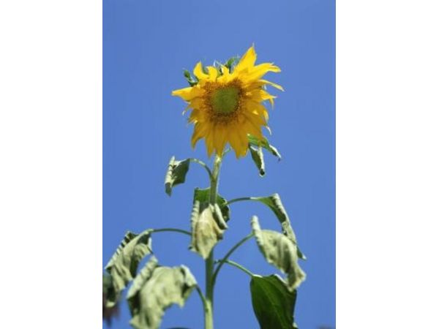
Advocacy Corollaries

Slide 22
COACHING

Slide 23
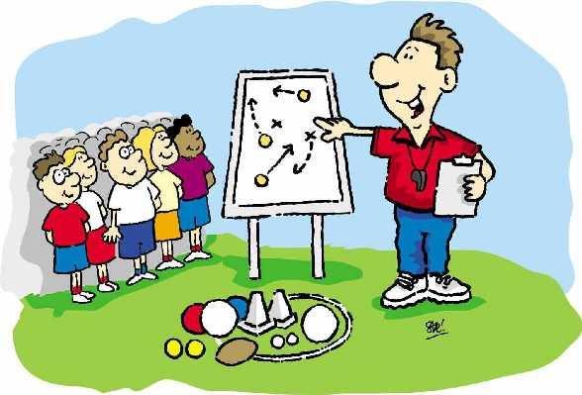

Slide 24
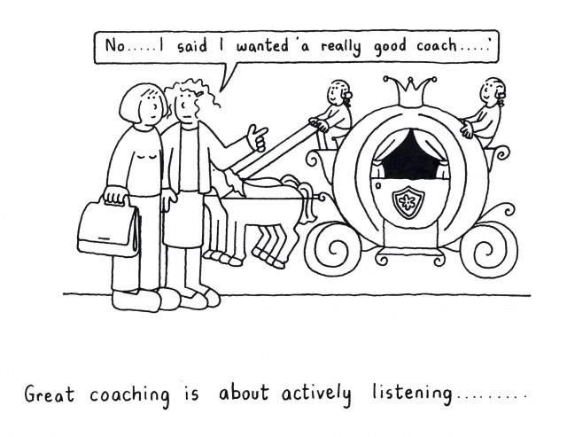

Slide 25
Documenting the process of change
Pod Meetings – Quarterly
What are the barriers to implementing the new approach?
What contributes to success?
Intentional Learning Communities

Slide 26
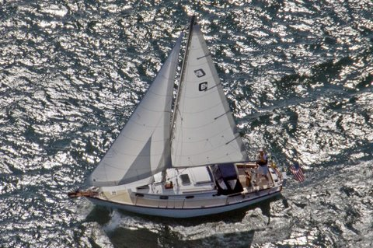
Notes:
We’re underway. We are half-way through now but the course is basically set.

Slide 27
THE VISION THING

Slide 28
Scene from Lake Michigan

Slide 32
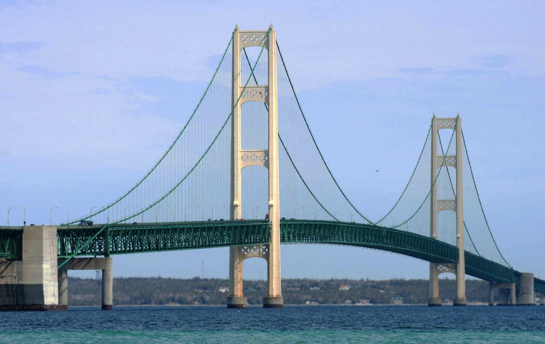

Slide 34
TIMELINE

Slide 35
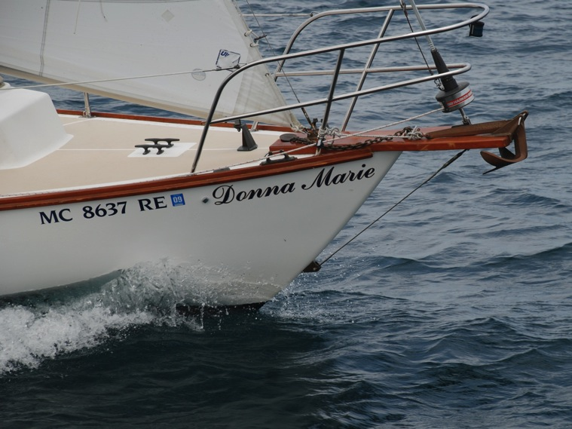
On we go!
Collect data to March 2015; (3 years).
Embargo details of training for now.
QIC Resources available on website.
Final Report – December 2015.

Slide 36
Summary
QIC National Needs Assessment
STATE OF CHILD REPRESENTATION
Compilation of academic articles and state laws
Model acts and monographs
QIC Best Practice Model
Exciting and promising empirical research
6 core skills – engaging the best of the lawyer skill set for better child results.

Slide 37
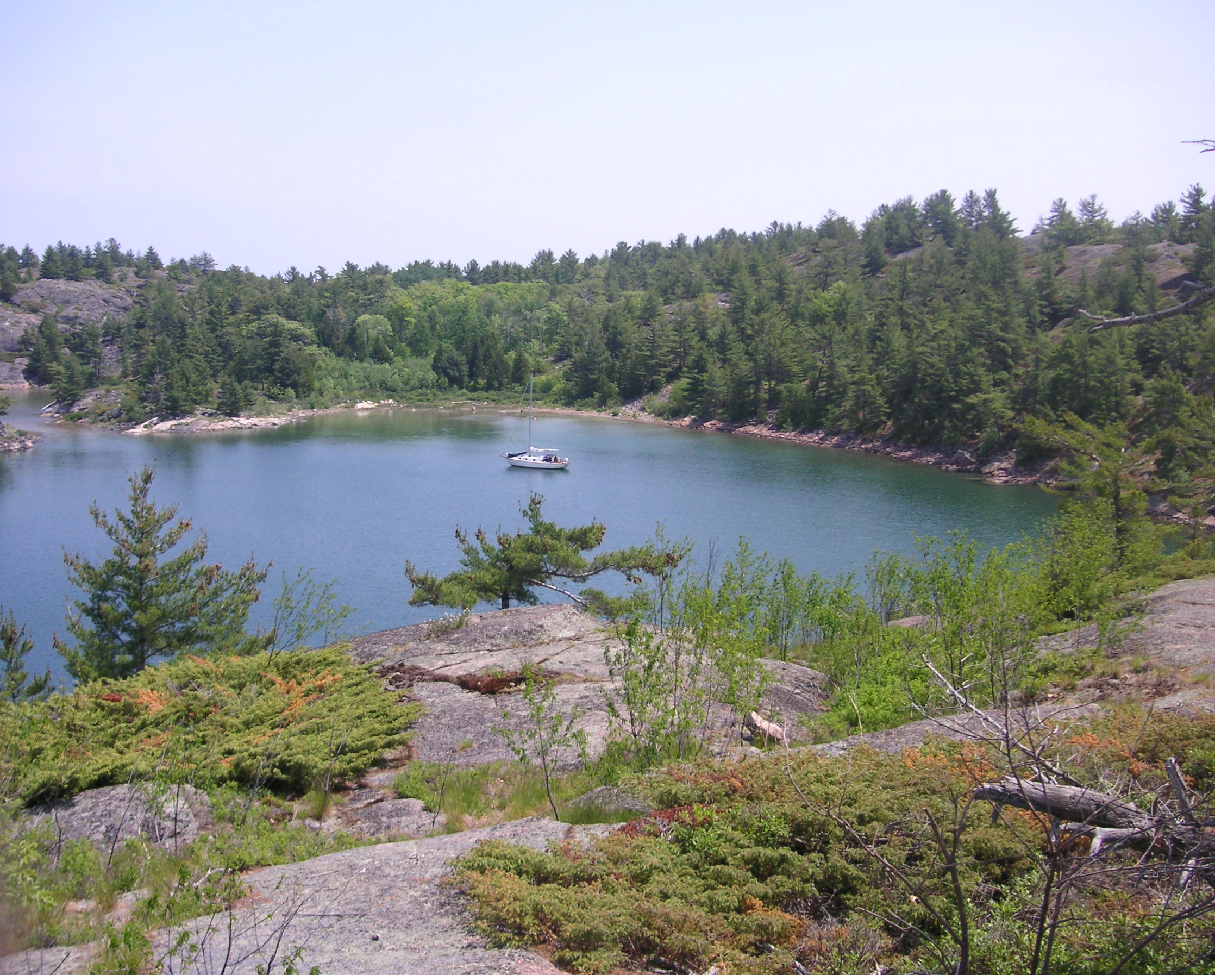
Notes:
The journey continues. Let’s pause here in a quiet and safe spot. Throw out the anchor. Questions, Comments, suggestions about the adventure so far?

Slide 38
www.ImproveChildRep.org
On a Mission to Improve Justice for Children Through Knowledge Development and Dissemination

